Slide 1

Affiliate Group Benefits

Slide 2
Who We Are
Think Realty is the premier media platform for real estate investors, featuring timely news, education, exclusive events, tools, and more. We positively impact investors throughout their real estate journey with accurate and timely strategies and in-depth content.

Slide 3
Our Membership
23,000 + active Think Realty members nationwide
300+ REIAs and groups in the Affiliate Program
Members include investors, rehabbers, flippers, landlords, property managers, contracts, and real estate professionals
40% own 20+ properties
Members rehab and flip 100,000+ properties/year

Slide 4






Think Realty Magazine is America’s foremost REI magazine with spotlights on successful investors, best practices, industry trends, and news.
Resident Expert Video Courses quickly deliver information and strategies on high-demand, must-know facets of REI.
Digital Content brings daily news updates and educational articles, weekly podcasts, live webinars, and more.
Digital Resources include REI calculators, downloadable checklists, templates, eBooks, and more.
Conference & Expo features a high-energy environment where you’ll network with top-tier investors, meet specialized vendors, and attend sessions and specialty workshops.
Savings Program brings discounts of up to 50% from our trusted partners.

Slide 5
Savings Program
Leveraging the buying power of our 23,000+ membership, we’ve negotiated steep discounts from top brands to save you up to 50%.
With the Savings Program, you’ll:
Learn about products and solutions that will save your business time and money.
Earn discounts-on-top-of-discounts with partner extra promotions and events.
Access white-glove service when you need help with large or unique purchases.

Slide 6













Slide 7
Access 140,000+ contractor items, including appliances, plumbing, electrical, and HVAC products.
Additional savings on the top 1,500 contractor items.
Exclusive brand products for up to 40% off comparable national brands.
Dedicated Account Manager for Think Realty Savings Program Members.
Easy online ordering, including mobile app.
Nationwide distribution and pickup – next day delivery to 98% of the country.
Requires a credit application and licensed business (ex: LLC).

Slide 8
Nationwide, full-service construction and tool rental.
10% off single day rentals, 15% off weekly rentals, 20% off monthly rentals.
600+ locations with dispatchers, mechanics, and delivery vehicles.
24/7 emergency service provides the confidence that you can complete any job on-time and on-schedule.
Requires a Sunbelt Rentals credit and rental application.

Slide 9
Discounts in store with your downloadable Store Purchase Card.
Discounted online pricing brings you the best savings.
Up to 55% off retail on various office supply, cleaning, and break room items.
Average of 10% savings on technology solutions.
Ink & Toner 10% off Branded / 20% off Private Brand.
Special print and copy pricing – up to 40% off black & white copies; 25% off color copies.
Free next-day shipping on orders of $50 or more.

Slide 10
Save up to 73% off Regular Retail Pricing on approximately 85 core items.
Commercial discounted rate on all 60,000 quality batteries, light bulbs, accessories & more.
Over 700 locations, open 7 days per week with morning and evening hours, plus 24/7 online shopping.
Extensive in-stock inventory plus flexible delivery options, store pickup and curbside service.
End-to-end best practice solutions for product disposal.

Slide 11
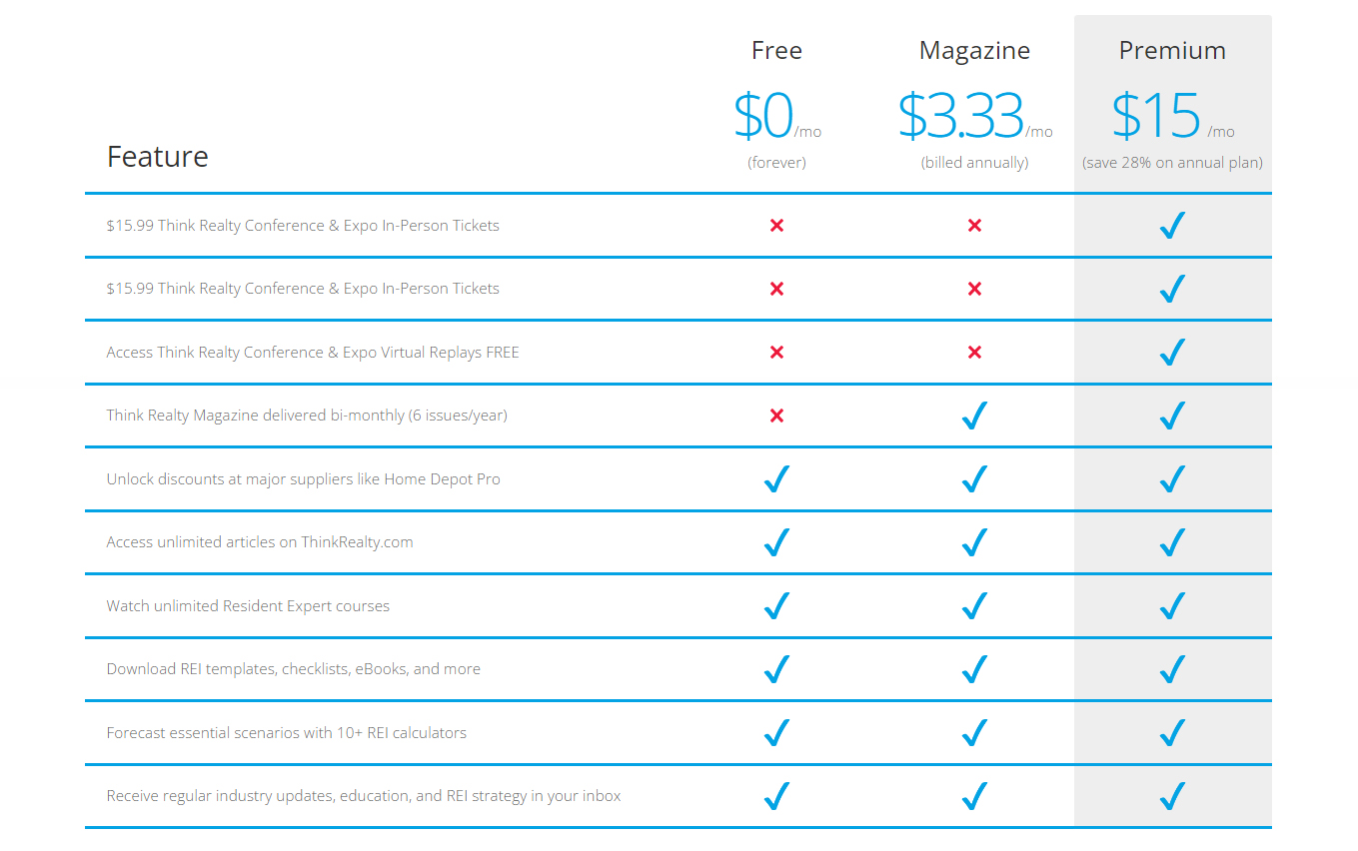
Membership Options

Slide 12
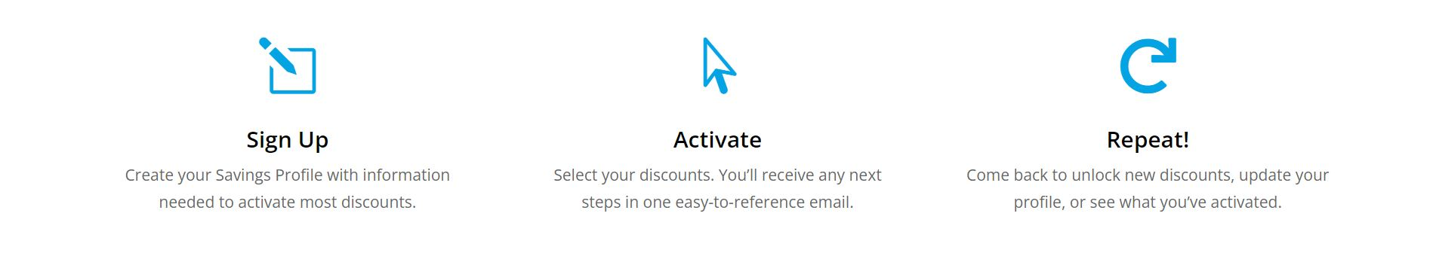
Sign Up Today!
https://thinkrealty.com/think-savings/
Use this code during signup: YOUR CODE HERE!!!
Signing up for the Savings Program automatically enables all benefits included in a FREE Think Realty membership. You can upgrade to add a Magazine or Premium membership at any time at https://thinkrealty.com/join/.

